Slide 1
3D Mammography™ Imaging and Breast Density Assessment
Notes:
With this presentation, I will share information surrounding the challenges of imaging dense breast tissue and the use of 3D™ Mammography as a solution.

Slide 2
Objectives
Understand imaging and density reporting challenges
Review ACR® BI-RADS® categories
Describe Automated Breast Density Assessment Software
Discuss 3D Mammography™ examinations
Risk Factors associated with dense breasts
Notes:
Here are my objectives for this presentation.
Understand the imaging and reporting challenges for dense breasts
Risk Factors associated with dense breasts
Review ACR BI-RADS® categories
Discuss 3D™ Mammography examinations
Describe Automated Breast Density Assessment Software

Slide 3
Challenges of Dense Breasts
Notes:
These first few slides will review the anatomy of the breast and discuss how the breast density is evaluated on a mammogram.

Slide 4
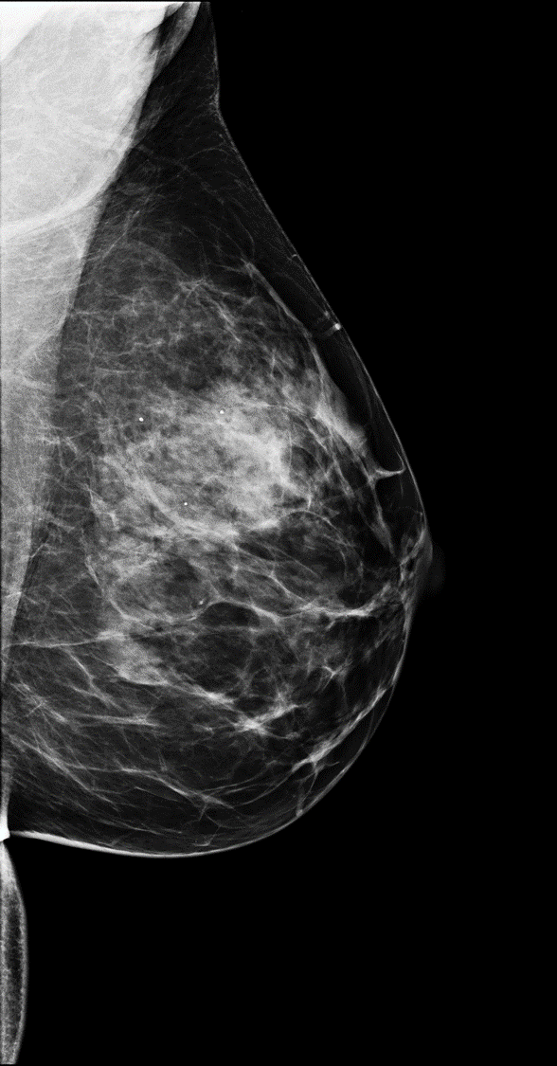
A
B
  A – Pectoral Muscle
  B – Fatty tissue
  C – Fibroglandular tissue
  D – Nipple
  E – Inframammary Fold
C
D
E
Notes:
Breasts are composed of lobules/glandular tissues, ducts, fibrous tissues and fat. “Fibroglandular tissue” is a combination of glandular and fibrous tissue.
The higher the proportion of ‘fibroglandular tissue’, the denser the breast.
Breast density is determined by the amount of fibroglandular tissue (dense) and the amount of fat (not dense).
On mammograms, fat is dark and everything else is white, including cancers.
Finding a “white” cancer against a dark fatty background is relatively simple, but
Finding a “white” cancer against a dense white background is challenging.
When the breast tissue has more density to it, the radiologist is challenged to determine what is real or true and what is false.

Slide 5
RCC
RCC
Notes:
Please notice the image on the left side of the screen. There is more fatty tissue than dense tissue. Finding a “white” cancer against a dark fatty background is relatively simple
Left click
But now, the image on the right, has more dense tissue than fat and this makes it challenging for the radiologist: Finding a “white” cancer against a dense white background is challenging

Slide 6
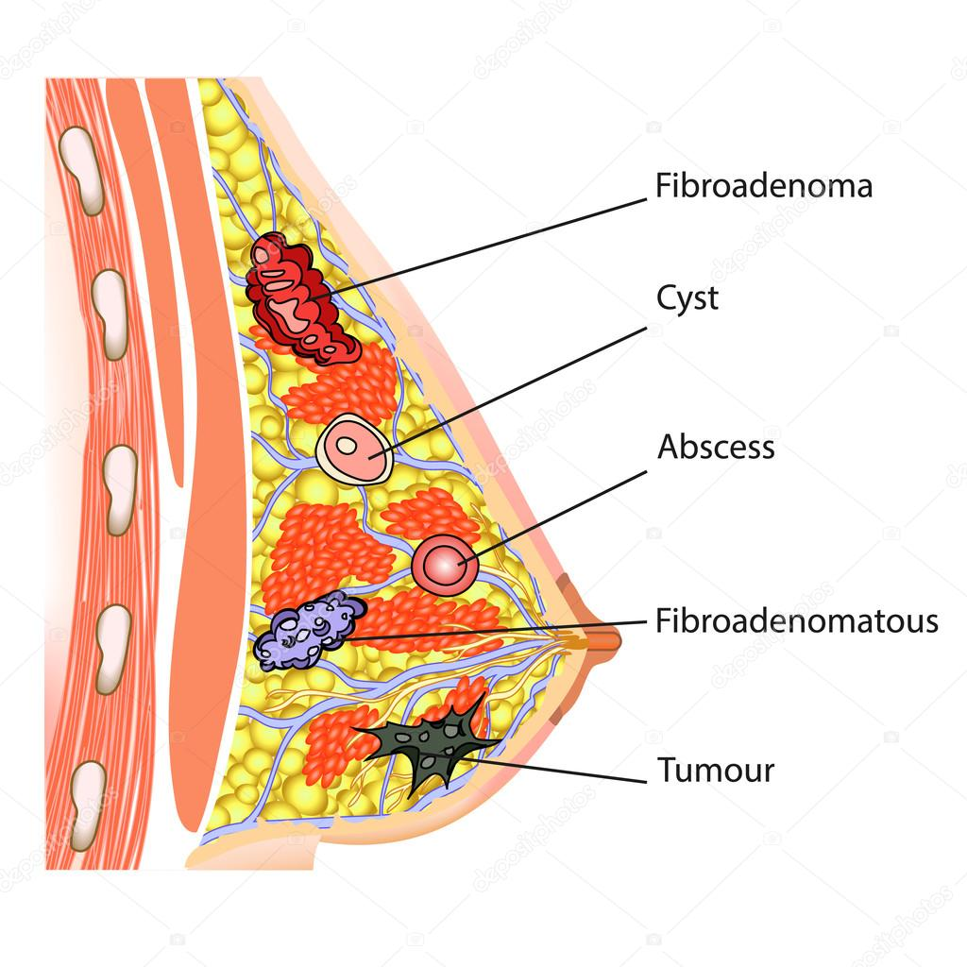
Notes:
In this picture, which identifies different abnormalities, imaging the breast can produce images that can create challenges for the radiologist. Because dense tissue may hide lesions or mimic lesions due to superimposition of the structures. The radiologist realizes that the denser the tissue is, identifying abnormalities becomes more challenging to diagnose.
(optional slide)

Slide 7
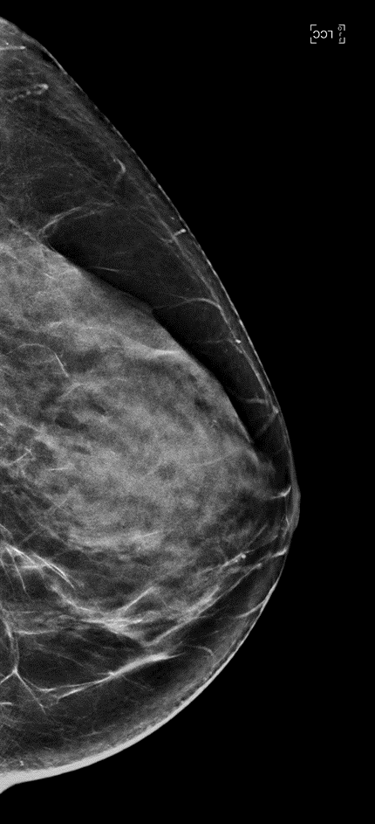
Challenges of Dense Breasts
Density may hide or potentially mimic cancers²
¹Stomper PC, et al. Analysis of parenchymal density on mammograms in 1353 women 25-79 years old. AJR Am J Roentgenol 1996;167(5):1261–1265.
² www.komen.org/BreastCancer/HighBreastDensityonMammogram.html
Notes:
Breast density also correlates to the degree of difficulty in reading mammographic images because it may hide or mimic breast cancer.
(optional slide)

Slide 8


Challenges of Dense Breasts
¹Stomper PC, et al. Analysis of parenchymal density on mammograms in 1353 women 25-79 years old. AJR Am J Roentgenol 1996;167(5):1261–1265.
Notes:
Of women in their early 40s, about 13% have extremely dense breasts and 44% have heterogeneously dense breasts, and by the age of 70, 2% have extremely dense and 24% heterogeneously dense breasts (1).

Slide 9
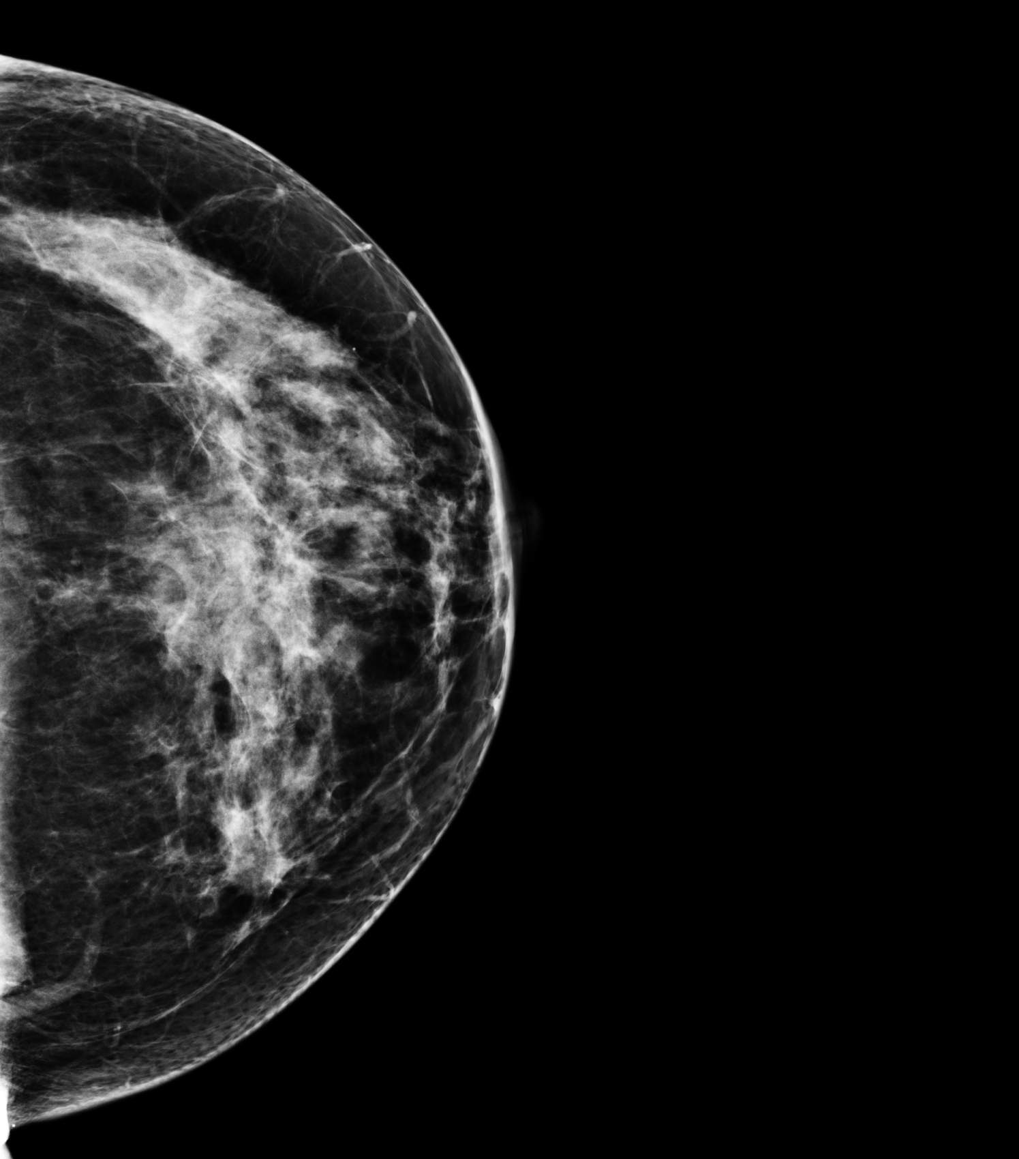
Breast Density and Risk Factors
Notes:
A number of factors can affect breast density, such as age, menopausal status, the use of certain drugs (including menopausal hormone therapy), pregnancy, and genetics.
More than half of all women who develop breast cancer have no known risk factors other than being female and aging.

Slide 10
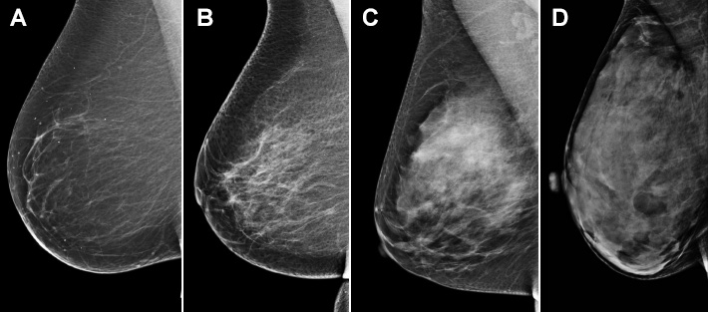
Breast density is one of the strongest risk factors associated with breast cancer
a
b
c
d
Breast density represents a stronger risk factor than having two first degree relatives with the disease
Breast Cancer Risk Factors You Cannot Change – ACS.org
Notes:
Gender and age are the two major factors, but also a woman’s breast density can be a strong risk factor.
Breasts are made up of fatty tissue, fibrous tissue, and glandular tissue as seen in these 4 different breast tissue types. Someone is said to have dense breasts (on a mammogram) when they have more glandular and fibrous tissue and less fatty tissue.
The 4 images displayed, starting on the left side, depict a completely fatty breast to a very dense breast, as seen on the far right.
Women with dense breasts on mammogram have a risk of breast cancer that is about 4 times that of women with fatty breasts. Unfortunately, dense breast tissue can also make it harder to see cancers on mammograms.
.

Slide 11
But Why is Breast Density a Concern?
It increases the risk of cancer and the risk of harms
Risk Increase:
BRCA1/2: 6 – 11x
Family History: 1.5 – 3x
Dense vs non-dense: 1.2 – 1.8x
Population Attributable Fraction:
Dense vs non-dense: 26% – 39%
Family History: 8.2% – 8.7%
BRCA1/2: 3 – 7%
a
b
c
d
¹ Engmann NJ, et al. Population-Attributable Risk Proportion of Clinical Risk Factors for Breast Cancer. JAMA Oncol. 2017
² Pasche B. Recent Advances In Breast Cancer Genetics. Cancer Treat Res. 2008
³ Brose, Marcia S., et al. "Cancer risk estimates for BRCA1 mutation carriers identified in a risk evaluation program." JNCI (2002):
Notes:
There is a need to assess breast density in women. Several studies have shown that an increase in a woman’s breast density equals an increased risk of breast cancer. Using the ACR’s BI-RADS classifications, (a, b, c & d), the chart indicates the relative risk with an increase in the breast’s density.

Slide 12
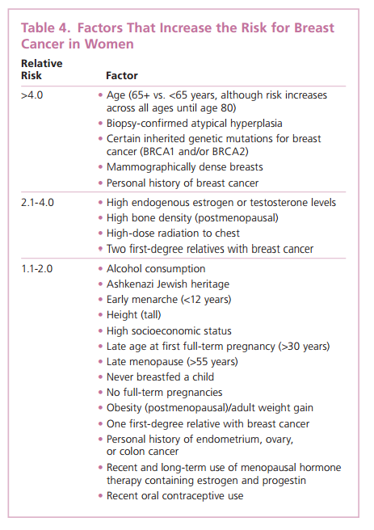
Breast Density and Risk
Some risk factors are a result of lifestyle choices
Others cannot be altered as they are a part of our human characteristics
Dense breasts, as seen on mammography, lie within the highest category of risk
American Cancer Society. Breast Cancer Facts & Figures 2015-2016. Atlanta: American Cancer Society, Inc.
Notes:
The American Cancer Society issues an annual Facts and Figures list. This list on the right, displays the relative risk and the factor. Factors that increase risk are labeled with the blue arrows
As you can see, several factors are due to lifestyle choices and those can be changed.
But mammographically dense breasts is a factor that has the highest relative risk. Indicated by the red arrow

Slide 13
ACR® BI-RADS® Classifications
2 Classifications
DISEASE ASSESSMENT
Category 0: Mammographic assessment is incomplete | Category 1: Negative | Category 2: Benign Findings | Category 3: Probably Benign Finding | Category 4: Suspicious Abnormality | Category 5: Highly suggestive of malignancy
BREAST TISSUE ASSESSMENT
a. The breasts are almost entirely fatty
b. There are scattered areas of fibroglandular density
c. The breasts are heterogeneously dense, which may obscure detection of small masses
d. The breasts are extremely dense, which lowers the sensitivity of mammography
Notes:
Most radiologists follow the American College of Radiology BI-RADS classifications for reporting purposes.
Note that there are two different BI-RADS assessments used:
A (CLICK) BI-RADS classification for disease assessment and a (CLICK) BI-RADS classification for breast composition assessment
For density reporting the (CLICK) Breast Composition Assessment is used. There are 4 breast compositions assessment catagories.
The radiologist may report the need for additional imaging based on breast density; (click) especially when reporting the breast tissue is heterogeneously dense or extremely dense.
Remember, Quantra also provides the BI-RADS-like breast composition assessments. Quantra is not a diagnostic tool; it is a solution that provides adjunctive information in breast composition assessment helping the radiologist to determine a reproducible and objective density assessment.

Slide 14
BI-RADS® Breast Density Categories, Demographics, Sensitivity of Cancer Detection, and Breast Cancer Risk ⇦
BI-RADS Category |  | Percentage of Population* | Sensitivity† (%) | Relative Risk of Breast Cancer‡
a | Almost entirely fat | 10 | 88 | ---
b | Scattered fibroglandular densities | 43 | 82 | ---
c | Heterogeneously dense | 39 | 69 | 1.2 (compared with average density)
d | Extremely dense | 8 | 62 | 2.1 (compared with average density)
Abbreviation: BI-RADS, Breast Imaging Reporting and Data System. *Pisano ED, Gatsonis C, Hendrick E, Yaffe M, Baum JK, Acharyya S, et al. Diagnostic performance of digital versus film mammography for breast-cancer screening. Digital Mammographic Imaging Screening Trial (DMIST) Investigators Group [published erratum appears in N Engl J Med 2006;355:1840]. N Engl J Med 2005;353:1773–83. †Carney PA, Miglioretti DL, Yankaskas BC, Kerlikowske K, Rosenberg R, Rutter CM, et al. Individual and combined effects of age, breast density, and hormone replacement therapy use on the accuracy of screening mammography [published erratum appears in Ann Intern Med 2003;138:771]. Ann Intern Med 2003;138:168–75. ‡Sickles EA. The use of breast imaging to screen women at high risk for cancer. Radiol Clin North Am 2010;48:859–78. BI-RADS = Breast imaging-reporting and data system
Notes:
Radiologists are required to report the breast density of the woman by following the American College of Radiology recommendations.
There are 4 BI-RADS categories: a, b, c, and d.
When the term ‘Dense Breasts’ is used, the breast tissue density falls into categories c or d.
47% are “dense”
Very small percentage are considered extremely dense.

Slide 15
American College of Radiology (ACR)
BI-RADS® categories
a
<25% DENSITY
FATTY BREAST
b
<50% DENSITY
SCATTERED DENSITY
c
>50% DENSITY
HETEROGENEOUSLY DENSE
d
>75% DENSITY
EXTREMELY DENSE
a b c d
BI-RADS = Breast imaging-reporting and data system
Notes:
(Optional slide)
These images represent the 4 BI-RADS categories: a, b, c, and d.
The ACR recommends that radiologists report an assessment of tissue composition.
Radiologists assess breast density: Most commonly it is a visual estimation…and unfortunately there can be quite a lot of variability amongst readers.
From two dimensional images
By estimating the amount of “whiteness” in a mammographic image

Slide 16
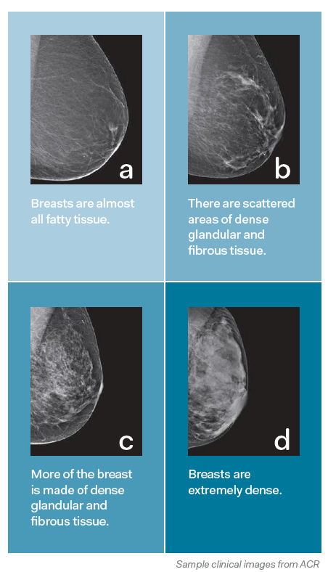
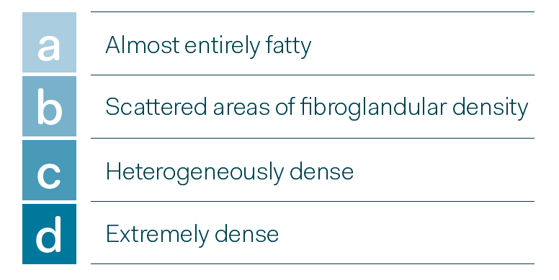
Breast Density Categories
American College of Radiology - BI-RADS, 5th Edition
Notes:
(Optional slide)

Slide 17
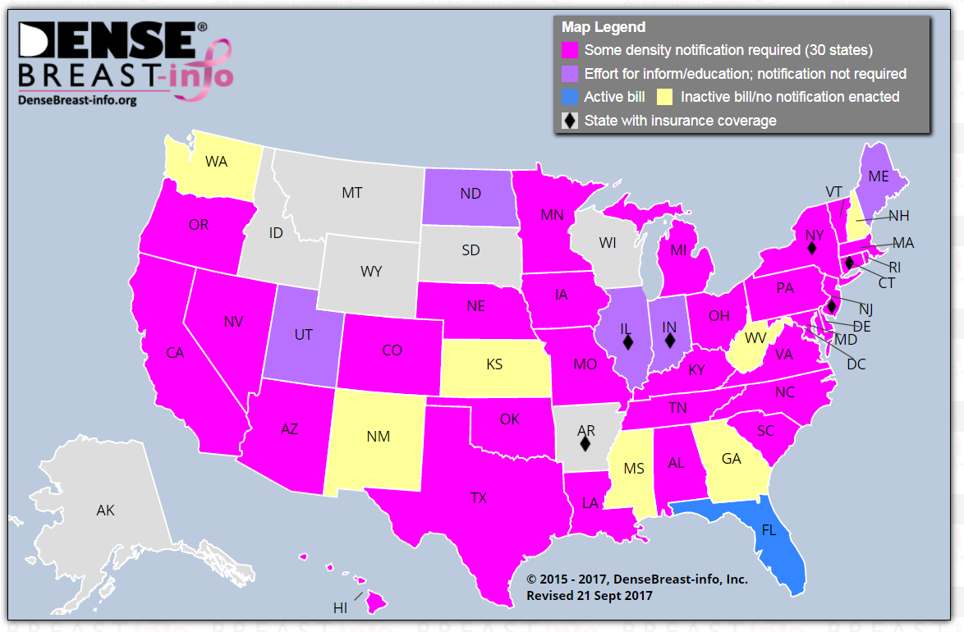
Breast Density Notification (BDN) Laws in U.S.
Notes:
Current as of (September 17)
This map identifies states that have breast density notification laws. As you can see, there are some states (yellow), have no active bills or notification laws enacted.
With each mammogram performed, radiologists state in their reports, a patient’s breast density.

Slide 18
Dense Breast Notifications Cause Uncertainty
All notification letters scored low on understandability
Letters create uncertainty and intensify disparities
74% of letters mention the association with increased cancer risk
65% mention supplemental screening as an option, advising women to consult their physician
Challenges for Patients – JAMA 2016
Kressin, Gunn, Battaglia, Content, Readability, and Understandability of Dense Breast Notifications by State; JAMA. 2016;315(16):1786-1788. doi:10.1001/jama.2016.1712
Notes:
The writing of dense breast notifications (DBNs) may affect women’s ability to understand their message.
STUDY: In JAMA, 2016, Kressin et al, shared the challenges that women face with understanding their dense breast notifications.
Poor Understandability
Discontinuity
Create Uncertainty
Intensify disparities
Efforts should focus on enhancing the understandability of DBNs so that all women are clearly and accurately informed about their density status, its effect on their breast cancer risk, and the harms and benefits of supplemental screening.

Slide 19
Breast Cancer Screening Guidelines
 | ACR/SBI | ACS | ACOG | AMA | NCCN | USPSTF
Age to start mammography | 40 | 45 – option to start at 40 | Offer at 40; not later than 50 | 40 | 40 | 50
Age to stop mammography | When life expectancy is <5-7 years | When life expectancy is <10 years | Age 75, then shared decision | Not stated | Not stated | 74 years
Mammography interval | annual | Annual 45-54; every 1 or 2 years 55+ | annual | annual | annual | Every 2 years
View on Digital Breast Tomosynthesis | No longer investigational; an advance in breast imaging | Improvement in detection, lower chance of recall | Not stated | Not stated | Improves cancer detection, reduces call back rates | Insufficient evidence to support routine use; grade “I”
Resources
ACR/SBI: SBI/ACR Statement: Doctors Believe in Power of Mammography to Save Lives, Recommend Screening Starting at Age 40
ACS: Oeffinger et al. Breast Cancer Screening for Women at Average Risk – 2015 Guideline Update from the American Cancer Society – JAMA 2015
ACOG: https://www.acog.org/About-ACOG/ACOG-Departments/ACOG-Rounds/October-2017/WPSI-Mammography-Screening-Recommendation-Supported-by-HRSA-and-Put-into-Action
AMA: REPORT 6 OF THE COUNCIL ON SCIENCE AND PUBLIC HEALTH (A-12) Screening Mammography – Executive Summary 2012
NCCN: NCCN Guidelines for Patients – 2016
USPSTF: https://www.uspreventiveservicestaskforce.org/Page/Document/UpdateSummaryFinal/breast-cancer-screening January 2016
Notes:
Another challenge for physicians and patients are the different organizations’ screening guidelines.
As you can see on the chart, there is a difference between groups as to when to begin screening mammography and their views on the latest technology, digital breast tomosynthesis.

Slide 20
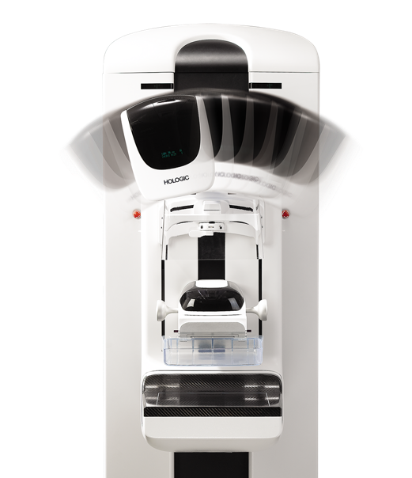
3D Mammography™
examinations
Notes:
Now my presentation will turn to the screening mammography examination.
One of the latest technologies to emerge over the last 5 years is digital breast tomosynthesis.
I will focus on the Hologic® system, Selenia® Dimensions®.

Slide 21
Tomosynthesis and Dense Breasts
Multicenter study 2011 - 2012
Evaluated differential screening performance of digital mammography + tomosynthesis compared with FFDM alone as a function of breast density
Results
The addition of tomosynthesis to digital mammography for screening was associated with an increase in cancer detection rate and a reduction in recall rate for women with both dense and non-dense breast tissue
All studies performed on Hologic 3D Mammography™ systems
Breast Cancer Screening Using Tomosynthesis and Digital Mammography in Dense and Non-dense Breasts
Elizabeth A. Rafferty, Melissa A. Durand, Emily F. Conant, Debra Somers Copit, Sarah M. Friedewald, Donna M. Plecha, Dave P. Miller, MS
JAMA April 26, 2016 Volume 315, Number 16
Notes:
Of 452,320 examinations, 278,906 were digital mammography alone and 173,414 digital mammography plus tomosynthesis; 2157 cancers were diagnosed. Recall rates per 1000 screens in non-dense breasts decreased from 90 to 79 and in dense breasts from 127 to 109 with tomosynthesis. Positive predictive value of recalls increased in both non-dense and dense breasts. Cancer detection rates also increased in both groups.
For subgroups of breast density, improvements in rates were greatest for women with scattered fibroglandular densities and heterogeneously dense breasts. Differences were mostly not significant for almost entirely fat and extremely dense subgroups.
These combined gains were largest for women with heterogeneously dense breasts, potentially addressing limitations in cancer detection seen with digital mammography alone in this group, but were not significant in women with extremely dense breasts. For women classified as having dense breast tissue, most have heterogeneously dense breasts, mandating caution in drawing conclusions regarding the performance of tomosynthesis for the small proportion of women with extremely dense breasts.

Slide 22
Terminology
Genius™ 3D Mammography™ exam
Acquired on the Hologic® 3D Mammography™ system and consists of a 2D and 3D™ image set, where the 2D image can be either an acquired 2D image or a 2D image generated from the 3D™ image set
Combo mode
Hologic exclusive mode that takes co-registered 2D and tomosynthesis images under one compression
Hologic low dose 3D Mammography™ exam
Unique low dose 2-view exam acquired with the Hologic 3D Mammography™ system and synthesized 2D
Notes:
Hologic’s has given a term to it’s tomosynthesis exam: Genius™ 3D Mammography™ examination.
Terminology slide – share with audience the current terminology used with Hologic’s tomosynthesis product

Slide 23
Recent FDA approval
The Genius™ 3D Mammography™ exam is now the only mammogram that is FDA approved as superior for women with dense breasts^{1,2}
In addition, only the Genius™ 3D Mammography™ exam detects 20-65% more invasive breast cancers compared to 2D alone, with an average increase of 41%²
¹FDA submissions P080003, P080003/S001, P080003/S005
²Results from Friedewald, SM, et al. "Breast cancer screening using tomosynthesis in combination with digital mammography." JAMA 311.24 (2014): 2499-2507; a multi-site (13), non-randomized, historical control study of 454,000 screening mammograms investigating the initial impact the introduction of the Hologic Selenia Dimensions on screening outcomes. Individual results may vary. The study found an average 41% (95% CI: 20-65%) increase and that 1.2 (95% CI: 0.8-1.6) additional invasive breast cancers per 1000 screening exams were found in women receiving combined 2D FFDM and 3D™ mammograms acquired with the Hologic 3D Mammography™ System versus women receiving 2D FFDM mammograms only..

Slide 24
What is Digital Breast Tomosynthesis (DBT)?
An advanced mammography procedure
Takes multi-angle exposures of the breast
Creates a volume rendering of the breast
3D MAMMOGRAPHY™ exams and 3D™ Mammograms are trademarks and/or registered trademark of Hologic, Inc.

Slide 25
Digital Breast Tomosynthesis (DBT)
FDA approved (Hologic) 2011
Currently, additional vendors have DBT systems: GE, Siemens, Fuji
Series of low dose x-rays obtained in arc above the breast
These “projection images” are reconstructed to obtain the 3D image set
Breast is viewed dynamically as 1 mm thick slices

Slide 26
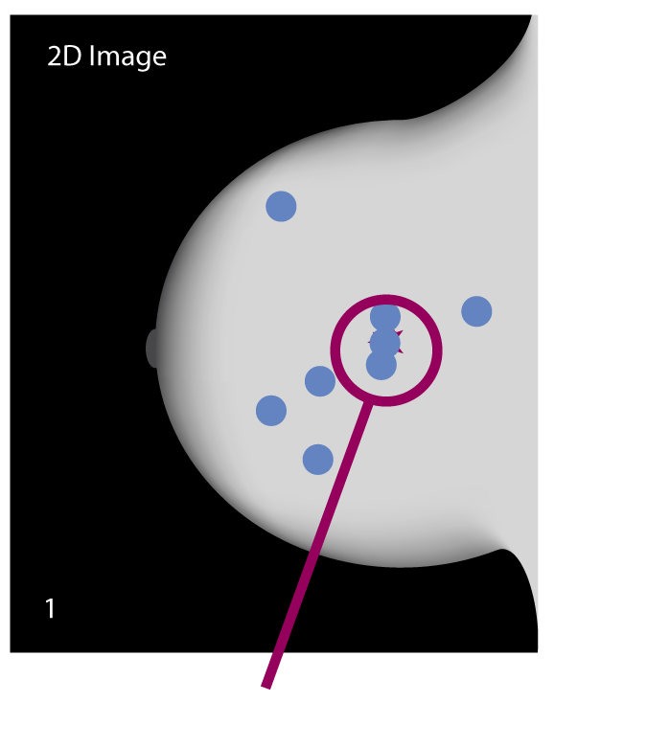
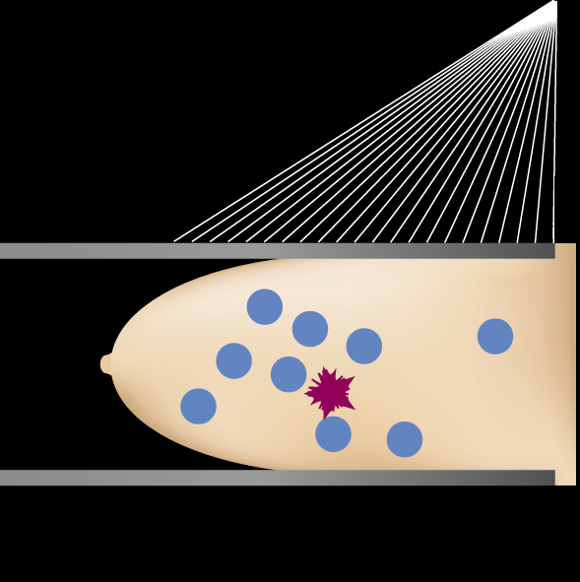
Advantages of Tomosynthesis
Tissue superimposition (2D)
  May hide pathologies in 2D
  May mimic pathology when doesn’t really exist
Notes:
(Click to display text)
So the motivations for digital breast tomosynthesis are quite simple and they are related to the two-dimensional nature of the imaging. In the figure on the left you can see a compressed breast and we will for the illustration in this example consider the blue circles to be normal fibroglandular structures in the breast and the red to be a cancer. A projection mammogram or two-dimensional mammogram might superimpose those objects onto the image and this creates two basic problems. One is that superimposition can hide pathologies and make it difficult to identify them and make it hard to see cancers in their earliest stages. We also have the situation that superimposition can mimic pathology and you can get overlapping normal structures which might appear unclear or possibly suspicious which require the patient to be recalled and undergo additional procedures to try to rule out the presence of disease. This not only is costly to the healthcare industry but it causes needless great anxiety to the vast majority of those women that are recalled because most are cancer free.

Slide 27
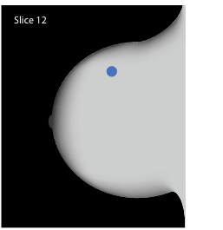
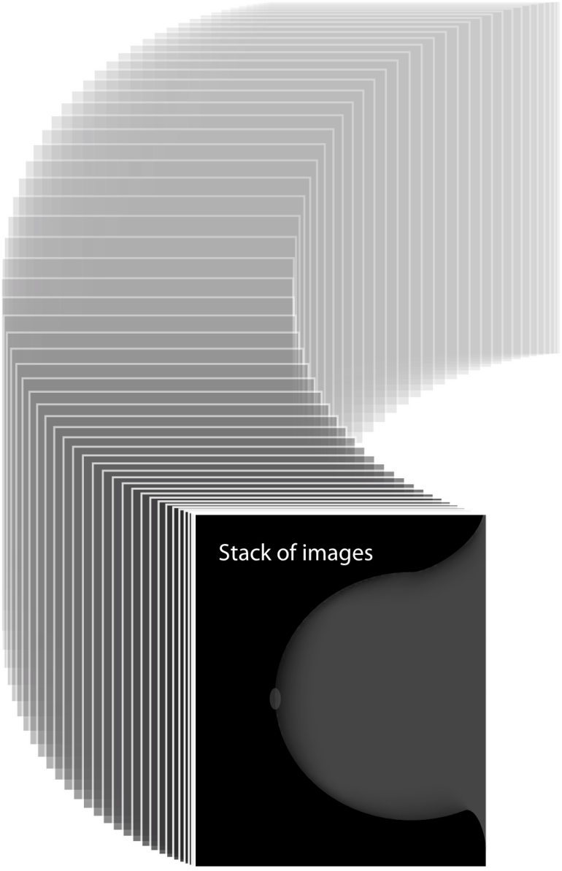
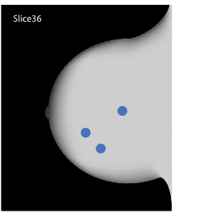
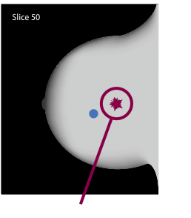
Breast Tomosynthesis Improves Visibility by Reducing Tissue Superimposition
Notes:
Click x 3 to demonstrate slices
With tomosynthesis, the radiologist is able to view the breast in 1 mm thick reconstructed slices
The slices allow improved visibility of all the breast structures

Slide 28
Two Imaging Methods
Tomosynthesis scan
Conventional 2D image
Synthesized 2D image
Notes:
With the Hologic mammography system, a tomosynthesis scan can be paired with the conventional 2D image (FFDM = full field digital mammography) or a synthesized 2D image with is created by C-View software.

Slide 29

Tomosynthesis Acquisition: Projection Images
Arc of motion of x-ray tube, showing
individual exposures
Notes:
Both image acquisition methods begin with the tomosynthesis scan.
The technologist positions and compressed the breast, then begins the exposure.
This exposure acquires 15 low dose images, these are called projection images.
A software algorithm is applied and creates 1 mm reconstructed slices.
The number of reconstructed slices is dependent upon the breast thickness.
Next, the C-View software can be applied to the reconstructed slices or the conventional 2D FFDM image can be acquired.

Slide 30
2D FFDM image is acquired under the same compression after the projections
2D mammogram
Notes:
The tube then returns to the perpendicular (0 degrees), the anti-scatter grid is returned into the field of view, and finally a normal 2D exposure occurs.

Slide 31


Generating 2D Images with Synthesized 2D image
Perform a standard tomosynthesis scan
Notes:
The first step to generating a 2D image is to perform the tomosynthesis scan
Click to display bullet & motion of x-ray tube
The image represents the x-ray tube moving to produce 15 low-dose projection images.

Slide 32
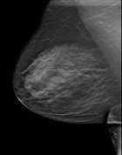

Generating 2D Images with Synthesized 2D image
Tomosynthesis Slices
Perform a standard tomosynthesis scan
Reconstruct tomosynthesis slices
Reconstruction
Algorithm
15 Projection Images
Notes:
After the acquired scan, the projection images will be reconstructed into 1 mm slices. There are an additional 5 slices reconstructed due to paddle tilt.
Click to display up arrow & bullet

Slide 33

Generating 2D Images with Synthesized 2D image
Tomosynthesis Slices
Perform a standard tomosynthesis scan
Reconstruct tomosynthesis slices
Generated 2D image
Available in any tomosynthesis view
Software
Algorithm
Generated 2D Images
Notes:
From the reconstructed slices, a software algorithm is applied and it creates the Generated 2D image.
Click to display down arrow & bullets

Slide 34
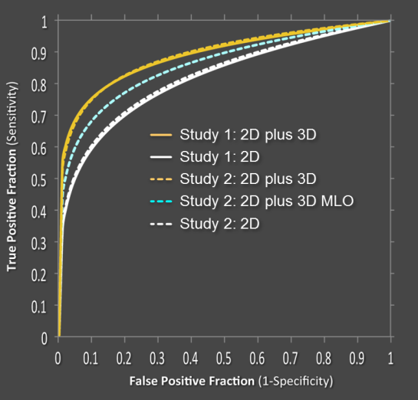
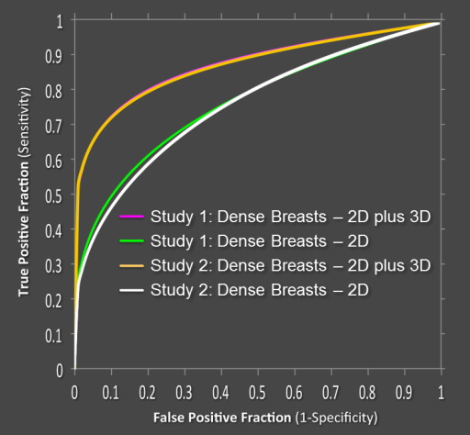
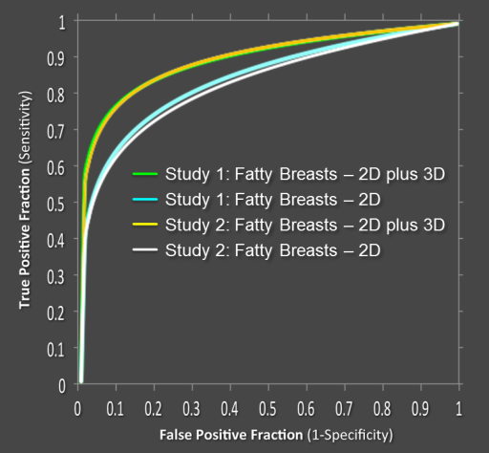
FDA approval/ studies
Positively moved the ROC curve, significantly
  All radiologists, regardless of experience/volume
Significant impact on all breast densities
  Fatty Breasts
  Dense Breasts
Pooled ROC: All Cases
All studies performed on Hologic 3D Mammography™ systems
Pooled ROC:
Dense Breasts
Pooled ROC:
Fatty Breasts
Notes:
Hologic’s approval from the FDA was based on data that proved a significant move of the ROC curve.
It also identified an impact on all breast densities; from fatty tissue to very dense tissue.

Slide 35
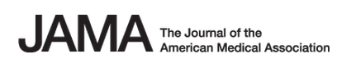
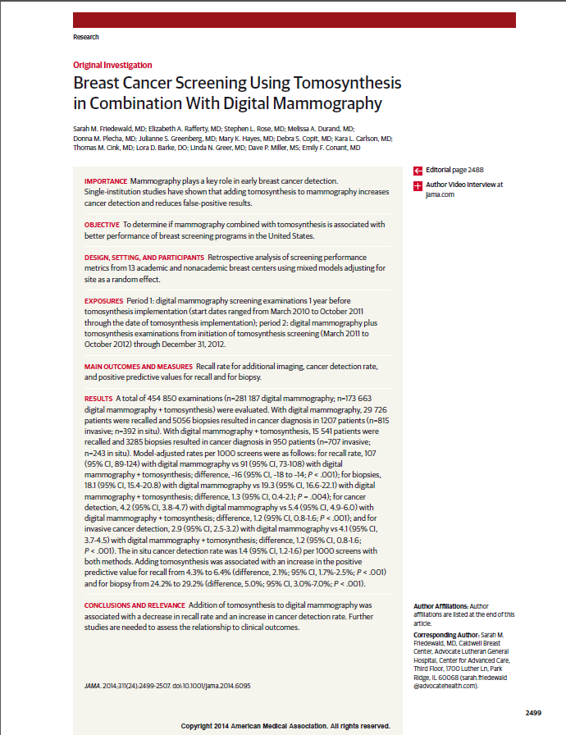
Emerging Clinical Evidence
Friedewald et al
13 different institutions
Academic
Community
139 Radiologists
454,850 examinations
281,187 FFDM
173,663 FFDM+Tomo
Friedewald et al. JAMA. 2014;311(24):2499-2507. doi:10.1001/jama.2014.6095

Slide 36
Genius™ 3D Mammography™ exams
Landmark Results
Invasive Cancer Detection
Finds 20-65% more invasive breast cancers compared to 2D alone¹
Reduces callbacks by up to 40% compared to 2D alone^{1,2}
Reduction in Recalls
Results from Friedewald, SM, et al. "Breast cancer screening using tomosynthesis in combination with digital mammography." JAMA 311.24 (2014): 2499-2507; a multi-site (13), non-randomized, historical control study of 454,000 screening mammograms investigating the initial impact the introduction of the Hologic Selenia Dimensions on screening outcomes. Individual results may vary. The study found an average 41% (95% CI: 20-65%) increase and that 1.2 (95% CI: 0.8-1.6) additional invasive breast cancers per 1000 screening exams were found in women receiving combined 2D FFDM and 3D™ mammograms acquired with the Hologic 3D Mammography™ System versus women receiving 2D FFDM mammograms only.
Bernardi D, Macaskill P, Pellegrini M, et. al. Breast cancer screening with tomosynthesis (3D mammography) with acquired or synthetic 2D mammography compared with 2D mammography alone (STORM-2): a population-based prospective study. Lancet Oncol. 2016 Aug;17(8):1105-13.

Slide 37
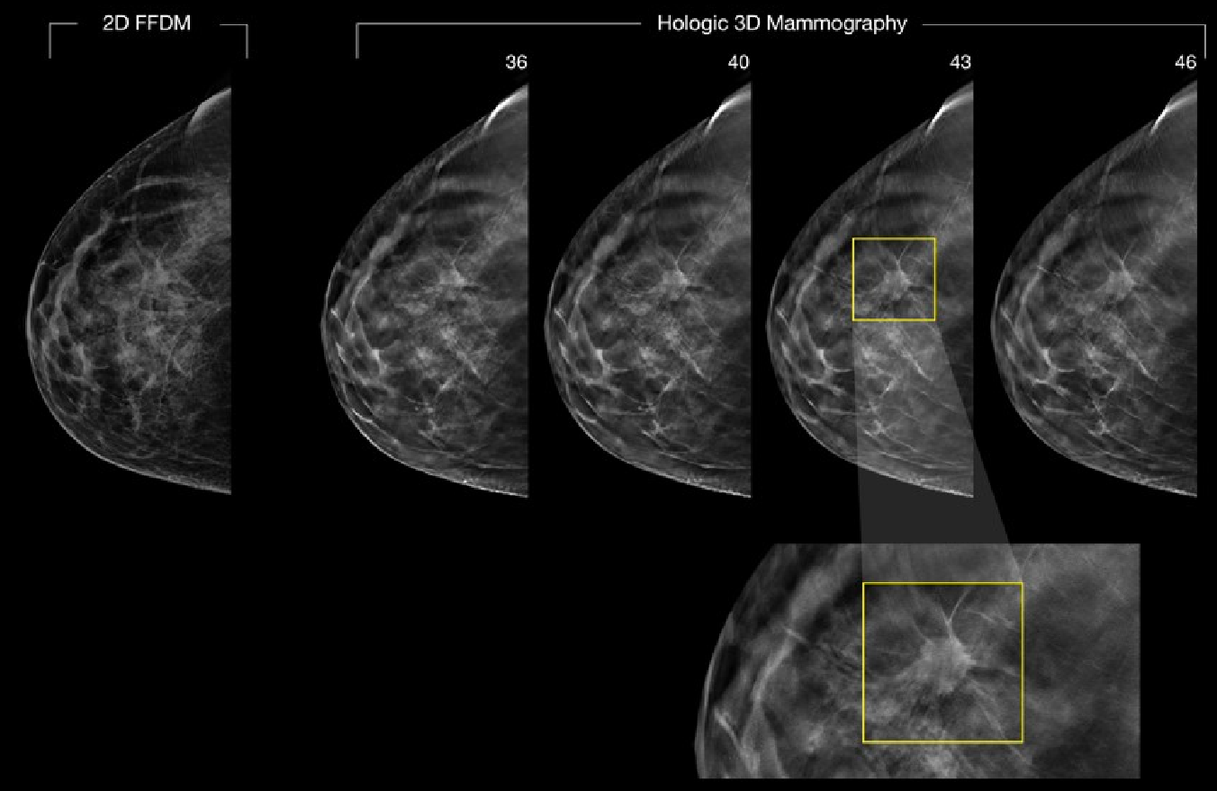
3D Mammography™ examinations can help
Notes:
Closer view of example images DBT slices that clearly identify the lesion that was less obvious in 2D
DBT helps prevent tissue overlap
Reduces Tissue overlap
Decrease Recalls due to false positives
Reduces unnecessary cost and anxiety1
Reduces missed cancer due to obscured lesions3,4
Presenter can point out how easily these lesion may have been overlooked on 2D

Slide 38
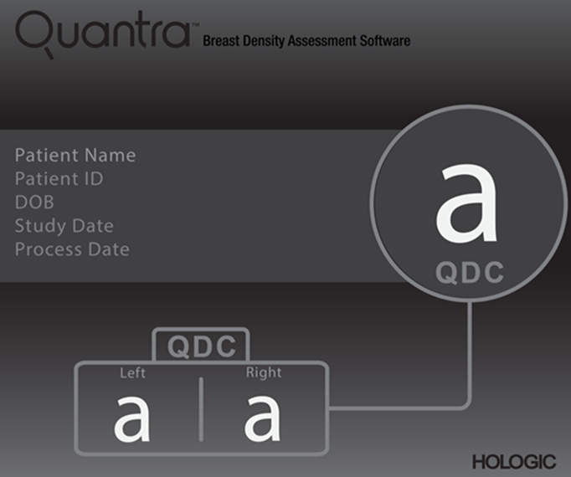
Quantra™ Breast Density Assessment Software
Notes:
Hologic® Quantra™ Breast Density Assessment Software
It has already been stated that radiologists review mammograms to assess disease and breast density.
There is another tool available for the radiologist: breast density assessment software.
This next section will give you information on the Hologic product, Quantra software.

Slide 39

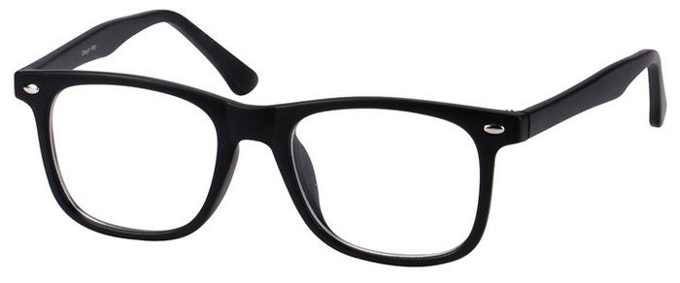

Quantra™ Breast Density Assessment Software
Breast density is globally recognized as
a risk factor for breast cancer¹
Current standard of care is visual / subjective, highly variable**
Radiologists estimate the amount of dense tissue
31 U.S. states have density notification laws**
¹ Variation in Mammographic Breast Density Assessments Among Radiologists in Clinical Practice: A Multicenter Observational Study. Ann Intern Med. doi:10.7326/M15-2934. Published at www.annals.org on 19 July 2016.
** Information found from public sources, such as public websites, government websites, and data from customers and public announcements, as of 28 September 2016. Hologic cannot verify the completeness or accuracy of this information.
Notes:
Patients are asking their physicians about their breast density
Women with dense breast tissue are advised of additional screening opportunities that may benefit them
Need for a consistent & user independent density assessment
Visual analysis is subjective, and not reliably reproduced
Quantra software provides a quantitative, consistent assessment of breast density

Slide 40
Annals of Internal Medicine
Variation in Mammographic Breast Density Assessments Among Radiologists in Clinical Practice: A Multicenter Observational Study¹
Mammograms rated as showing dense breasts by radiologists using visual assessment ranged:
6% to 85%
* Variation in Mammographic Breast Density Assessments Among Radiologists in Clinical Practice: A Multicenter Observational Study. Ann Intern Med. doi:10.7326/M15-2934. Published at www.annals.org on 19 July 2016.
Notes:
Variation in Mammographic Breast Density Assessments Among Radiologists in Clinical Practice: A Multicenter Observational Study. Ann Intern Med. doi:10.7326/M15-2934. Published at www.annals.org on 19 July 2016.
The challenge in assessing breast density is in

Slide 41
Quantra™ Breast Density Assessment Software
a quantitative, consistent assessment of breast density
Notes:
Quantra software provides a quantitative, consistent assessment of breast density
In response to the ACR BI-RADS 5th Edition change, Hologic updated its Quantra™ algorithm to include proprietary machine learning in its analysis of pattern and texture.
This is an example of the Quantra results that the radiologist can review.
QDC = Quantra Density Category
Quantra software evaluates each breast and identifies the BI-RADS category

Slide 42
Quantra™ Breast Density Assessment Software
Designed to provide more consistent and reproducible breast density assessment
Offers more confidence in selecting which patients (dense tissue or not dense tissue) for additional screening
Radiologist can choose to include Quantra™ report results in patient mammography results letter

Slide 43
Placeholder for cases - KOL

Slide 44
Summary
Over 40% of women have heterogeneously or extremely dense breast tissue
Difficult to detect cancer on mammography
Hologic 3D Mammography™ aids in detecting breast cancer in all breast density types
It is a risk factor
Increase in detecting invasive breast cancers
Reduces the need to recall patients
Breast density assessment software
Provides consistent and reproducible density assessment

Slide 45
Thank you!

Slide 46
Additional slides/cases

Slide 47
Case Review by Breast Density
Notes:
Now I would like to share a few cases with you to demonstrate the importance of 3D Mammography exams in its ability to image all breast density types, especially dense breast tissue.
I will go through cases that demonstrate the 4 BI-RADS categories for breast density.

Slide 48
Case 1 – Fatty tissue
Architectural distortion
4 mm lesion seen on 3D Mammography™ exam only
2D spots inconclusive
Notes:
RSNA case: 110_16AD Selenia Dimensions
This first case demonstrates the BI-RADS category ‘a’, fatty tissue.
In a moment you will see a bilateral screening mammogram and the breast tissue is composed of mainly fatty tissue.
The mammography study combines the conventional 2D images with 3D images or tomo reconstruction slices.
An area of architectural distortion was found only by tomosynthesis.

Slide 49
Bilateral 2D FFDM images
Notes:
The images on display represent the cranio-caudal views (CC views).
The right breast is on the left of the screen and the left breast on the right side of the screen.
These images are the conventional 2D full field digital mammography images.
The radiologist reviewed these two images and there was no indication of a lesion.

Slide 50
Bilateral 2D FFDM images
Notes:
These are the Medio-Lateral Oblique views (MLO views)
These images are the conventional 2D full field digital mammography images.
Again, the radiologist reviewed these two images and did not identify any suspicious areas.

Slide 51
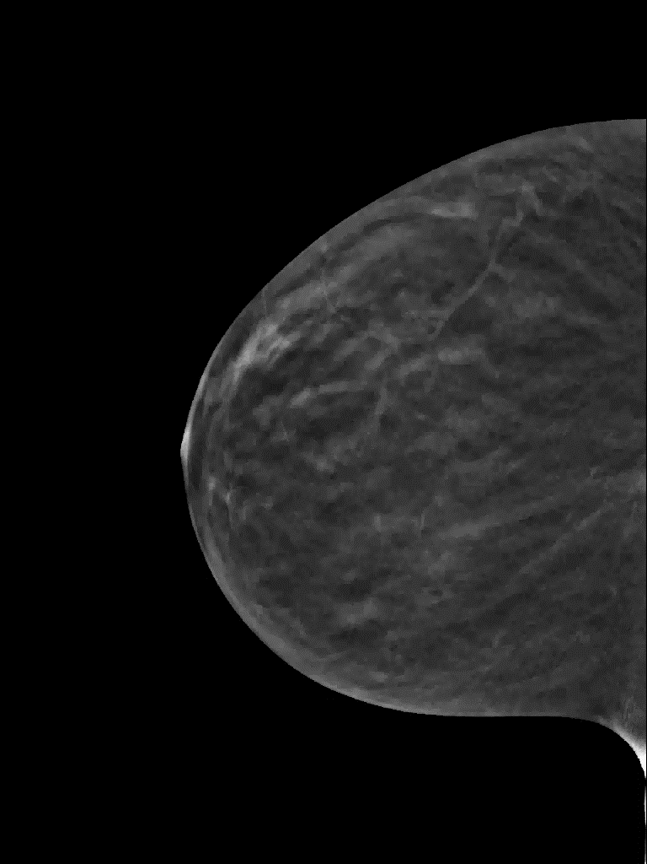
Notes:
When the radiologist started the review of the tomosynthesis reconstructed slices, she uncovered a spiculated lesion mid-breast. (left click to display arrow)
The image on the right side is a single reconstructed slice from the tomo data set.
On the left side of the screen, is all the reconstructed slices. Let’s review all the slices (left click to begin avi – lesion is best seen at 3:20 seconds into the avi)

Slide 52
Notes:
The radiologist had the technologist acquire 2 spot compression views in the conventional 2D method after reviewing the reconstructed slices.
She wanted to compare these focused compression spots to the tomo reconstructed slices.

Slide 53
Notes:
As you can see, the 2D compression spot did not identify the spiculated lesion which was easily identified on the 3D mammography reconstructed slices.
2D spots were inconclusive.

Slide 54
Case 1 – Fatty tissue
Architectural distortion
4 mm lesion seen on 3D Mammography exam only
    CC only
Invasive Ductal Carcinoma
Notes:
RSNA case: 110_16AD Selenia Dimensions
After core biopsy, the pathology results were (click to display) Invasive Ductal Carcinoma

Slide 55
Case 2 - Scattered areas of fibroglandular density
Extensive family history:
  Sister, cousins, aunt
3D Mammography™ finding
  CC only finding
Notes:
RSNA 2017: _08RS ClarityHD
The second case represents a patient that came in for her annual screening examination. As indicated, she has a strong family history of breast cancer.
Her breast tissue is the BI-RADS category ‘b’ = Scattered areas of fibroglandular density
This is another example of 3D Mammography finding that was not identified on the 2D images.

Slide 56
Bilateral 2D CC images
Notes:
First, these are the bilateral CC views.
As you can see, there is no asymmetry.

Slide 57
Bilateral 2D MLO images
Notes:
These are the bilateral 2D MLO views – there is no specific area that appears different.

Slide 58
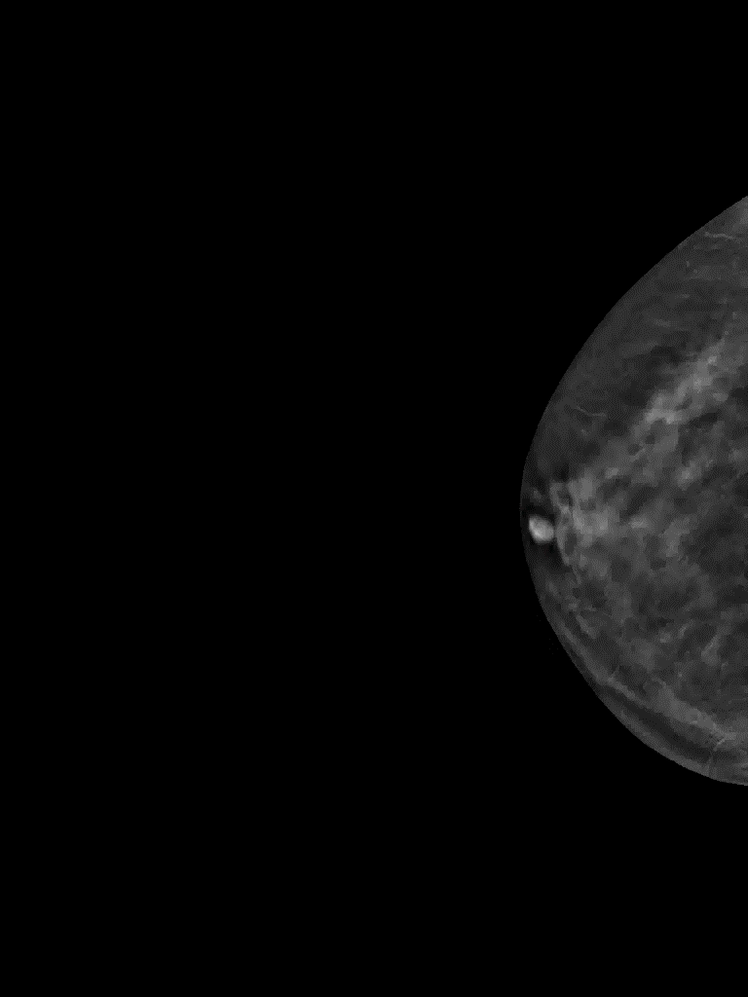
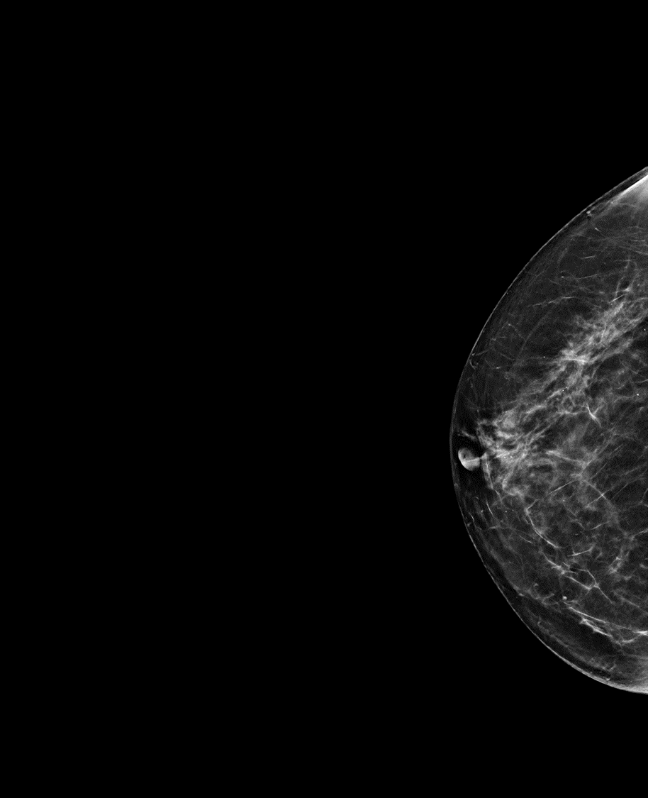
Notes:
The radiologist reviewed all the tomo reconstructed slices and found on the right CC view, an area of architectural distortion.
Left click to display arrow on right image
Left click on left image to go through reconstructed slices
the patient went on to have a breast MRI study and bMRI confirmed architectural distortion

Slide 59
Case 2 - Scattered areas of fibroglandular density
Extensive family history:
  Sister, cousins, aunt
CC only finding
Radial scar
  Benign with focal ductal hyperplasia without atypia
Notes:
The patient had a breast biopsy of the architectural distortion and the results: Benign – radial scar with focal ductal hyperplasia without atypia
Left click to display pathology results.

Slide 60
Case 3 – Heterogeneously dense
History of bilateral breast surgery
Strong family history:
  Sister, aunt, cousin
Notes:
RSNA case: _09M 2017
The BI-RADS category ‘c’ case represents a Heterogeneously dense breast.
The area of interest is the left inner quadrant.
This woman has a previous history of bilateral breast surgery as well as a strong family history.

Slide 61
Bilateral s2D CC images
Notes:
RSNA case: _09M 2017
Here are the CC images from the screening mammogram. These images are not the conventional 2D images but the 2D images generated from the C-View software.
The letter ‘s’ in front of 2D is for the word synthesized.
This is an excellent example of how a generated 2D image ‘highlights’ or defines areas in the denser breast tissue.
The area of interest is the left inner quadrant.

Slide 62
Bilateral s2D MLO images
Notes:
The synthesized 2D MLO views, which are created from the tomosynthesis reconstructed slices, easily identifies an area of interest in the left breast.
Left click to display arrow to identify the mass.

Slide 63
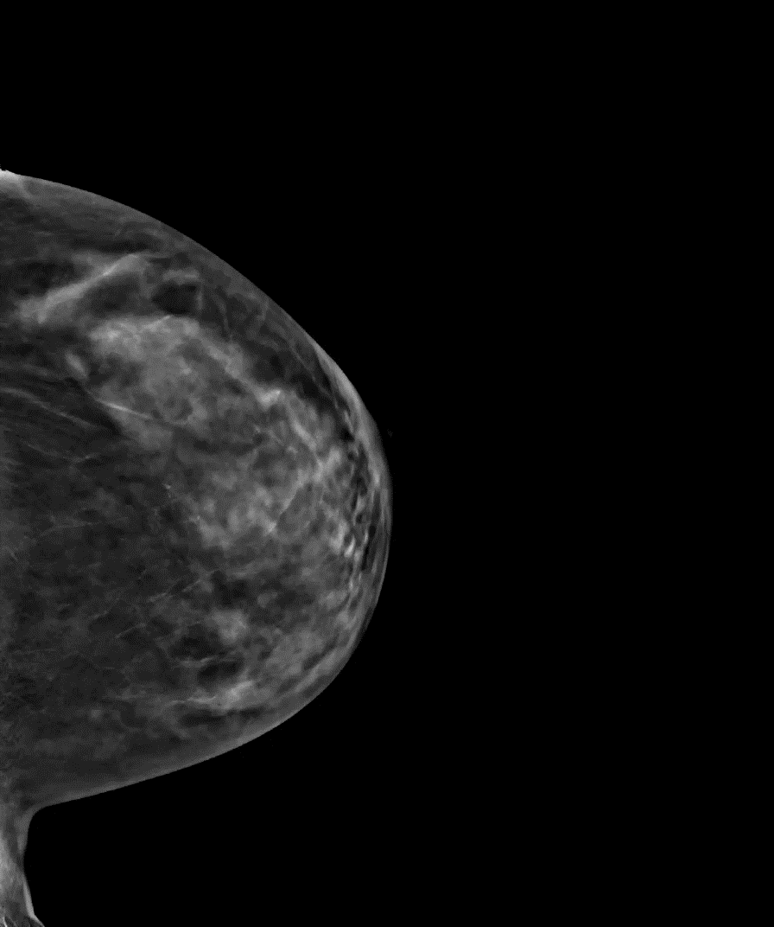
Notes:
Here is the left breast with the mass/spiculated lesion.
Let’s review the tomo reconstructed slices; left click to begin avi file. Best slice is at ~4.50 seconds

Slide 64
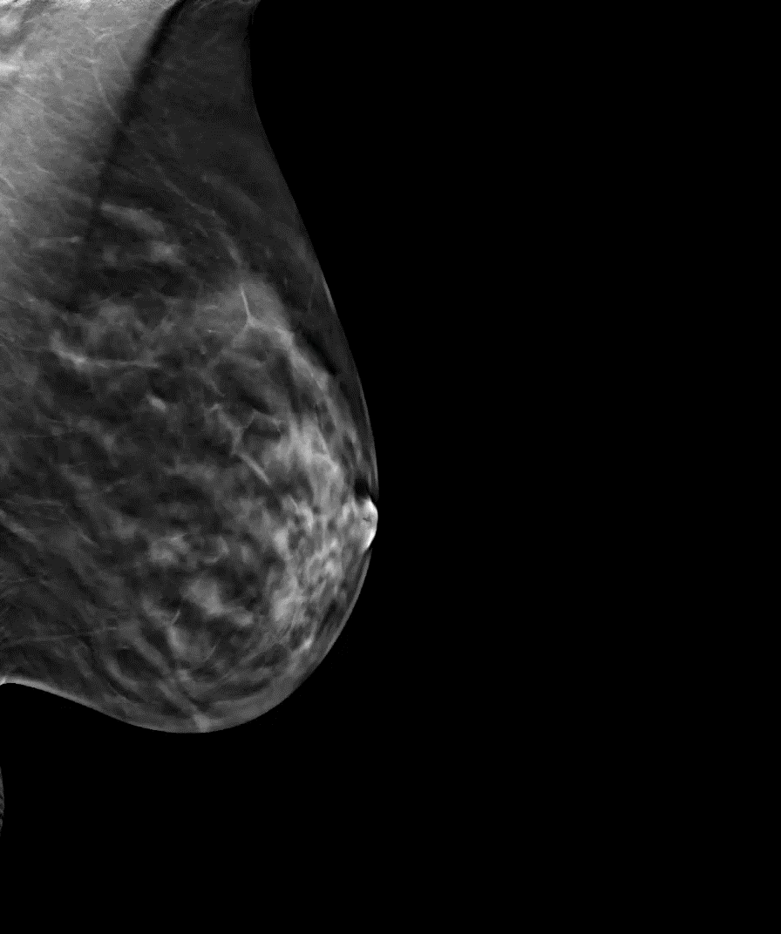
Notes:
Best slice is ~6 seconds
Left click to begin avi

Slide 65
Case 3 – Heterogeneously dense
History of bilateral breast surgery
Strong family history:
  Sister, aunt, cousin
Invasive Lobular Carcinoma
Notes:
RSNA case: _09M 2017
The pathology report (left click) was Invasive Lobular Carcinoma

Slide 66
Case 4 – Extremely dense
Architectural distortion
    Tomo only finding
Notes:
RSNA case 2016: 125_16AD
Now we enter into the review of how Genius 3D Mammography can identify abnormalities in dense tissue that may go undetected in the convention 2D imaging
Right 41/31 IDC Dense tissue – definitive on CC image
Architectural distortion
– tomo only
3D Q = D
Right 41/31 IDC Dense tissue – definitive on CC image

Slide 67
Bilateral s2D CC images
Notes:
Case 125_16AD dense tissue
These CC views are the Hologic C-View images, the synthesized 2D images.
As you can see, the tissue is extremely dense.

Slide 68
Bilateral s2D MLO images
Notes:
Case 125_16AD dense
The MLO C-View images also demonstrates dense tissue.

Slide 70
Case 5 – Extremely dense
Bilateral screening exam
Dense tissue

Slide 71
CC 2D images…
no lesion seen
Notes:
Dense breast – BI-RADS ‘d’
This study represents a combo mode acquisition.
First, let’s review the FFDM 2D images (FFDM = full field digital mammography views)
Here are the Cranio-caudal views or better know as CC views
Upon review, there were no abnormalities noted

Slide 72
MLO 2D images…
no lesion seen
Notes:
Dense breast – BI-RADS ‘d’
Here are the medio-lateral oblique views (MLO views), again, these are the FFDM 2D images (FFDM = full field digital mammography views)
there were no abnormalities noted in these views

Slide 73
2D
Tomo slice
Notes:
As the radiologist began to review the FFDM image, this being the right MLO view, next to a reconstructed slide of the tomo data set,
(left CLICK)
A spiculated lesion came into view – left click again to display circle over ROI

Slide 74
2D spot view
Tomo slice
Notes:
On this slide, the comparison is made between the reconstructed tomo slice on the right to a 2D spot view.
A spot view is an image of focused compression over a specific area.
As you can see, the 2D spot view did not display the spiculated lesion that is seen on the tomo slice.
This is one case that proves the point of imaging denser tissue with tomosynthesis technology.
This was an invasive ductal carcinoma.

Slide 75
Case 5 – Extremely dense
Bilateral screening exam
Dense tissue
Invasive Ductal Carcinoma
Notes:
Pathology results: invasive ductal carcinoma

